Slide 1
Open Source Software Engineering
SE ZG587
Kumar Manish
28 Oct 2023

Slide 2
Session 13 : Git and GitHub....

Slide 3
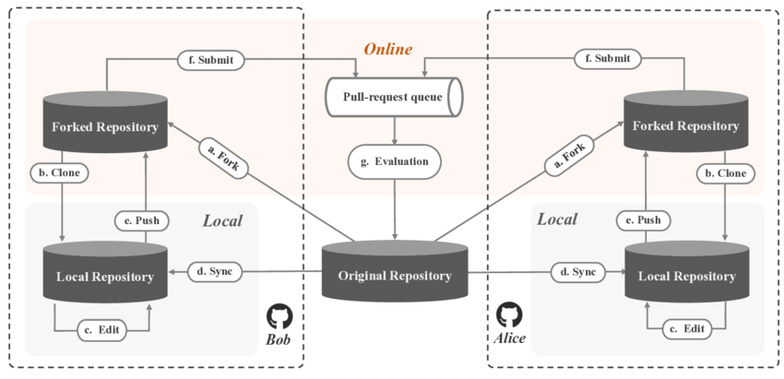
Working with git & GitHub
Git Workflow - Pull based model

Slide 4
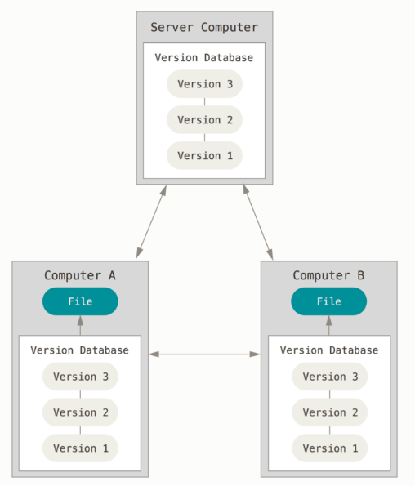
GIT : Distributed version control system

Slide 5
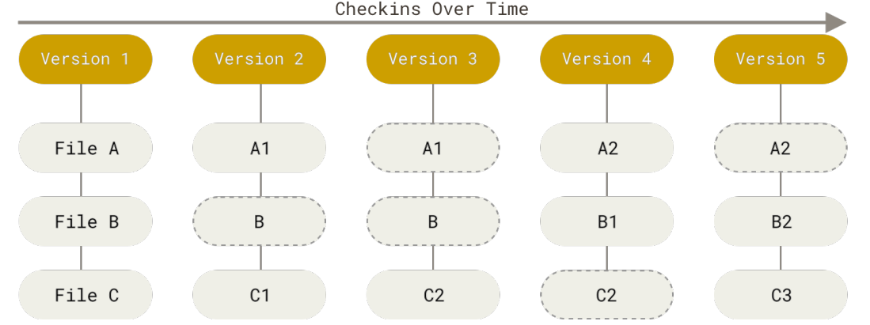
Unique Characteristics of Git
Storing data as snapshots of the projects over time
Stores Snapshots , Not differences

Slide 6
Unique Characteristics of Git
1.) Stores Snapshots , Not differences
Git does not uses the delta approach; rather it usage an approach in which it stores data like a series of snapshots of a miniature file system - Stream of snapshots
With every commit, Git takes a snapshot of all the files at that moment and stores a references to the snap shot.
If some files have not changed, Git does not store the file again, but only a link to the previous version of the same file, which is already stored with it.
This makes git more powerful , efficient and fast as compared to its counter
Also ,helps in implementing branching efficiently

Slide 7
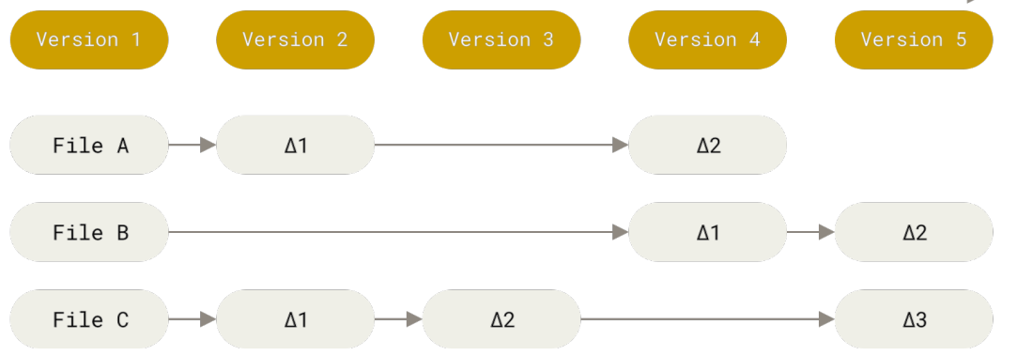
Characteristics of other version control system
Older VCS like Subversions, Perforce, etc store information as a list of file based changes knowns as delta –based version control – store only the changes made to each file over time

Slide 8
Unique characteristics of git
2.) Nearly Every operation is Local :
Nearly every operation in git requires only local files and resources to execute ; usually no information is required from other computers on the network.
This is because the entire history of the project is stored in the local computer of every individual , making various operation faster.
In order to browse the entire history of the project , Git does not need to get the same from the server – it simply takes it directly from the users' local database and the same immediately available.

Slide 9
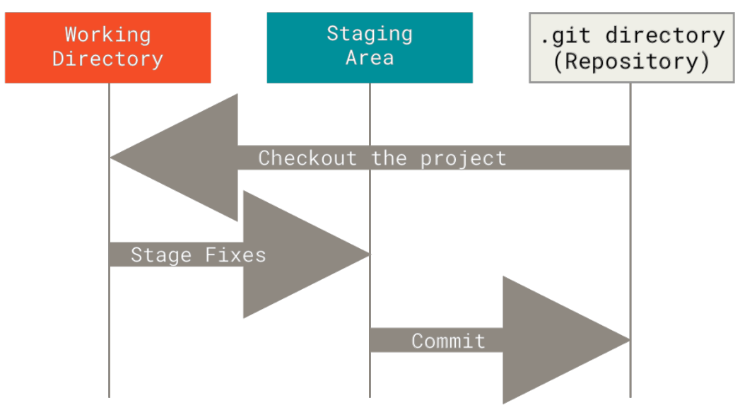
Unique characteristic of Git
3.) The Three stages in Git

Slide 10
Unique characteristic of Git
The three states in Git : In Git, a file resides in one of the three states : modified , staged and committed.
Modified state – The file has changed but the changes have not been committed to the database yet
Staged state - the file has ben marked as modified file in its current version and is marked to go in to the next commit snapshot.
Committed state – a file resides in this state is safely stored in the local database
Hence, Git project has three main section :
  The working tree
  The staging area
  And the Git directory

Slide 11
The three states in Git
The working directory is the single checkout of the latest version of the projects. The project files are pulled out of the compressed database in the Git directory and placed on disk for use.
The Staging area is a file , usually contained in the Git directory, and stores the information about the files that are staged and are hence marked what go into the next commit.
The Git directory is used by Git to store the metadata and object database for the project. This is the most important part of Git, and is copied to the local system when a repository is cloned from a remote repository

Slide 12
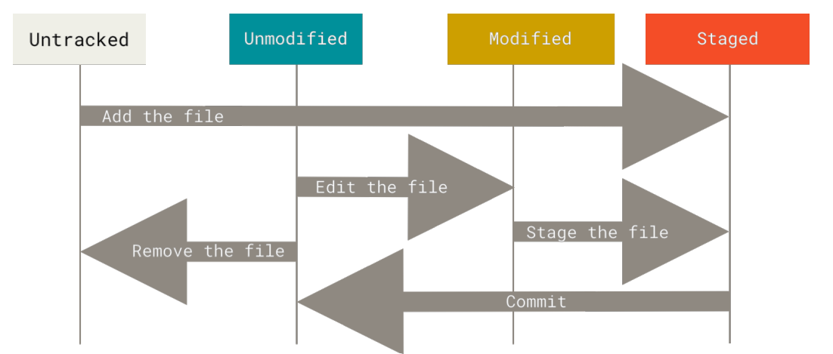
Life cycle of the status of Files

Slide 13
Basic Git workflow
The basic git workflow goes like this :
The file are modified in the working directory
The filles are selectively staged and only those changes that are required to be part of the next commit are moved to the staging area
Commit is executed, which takes the files as they are in the staging area and stores that snapshot permanently to the Git directory

Slide 14
Git Branching
Need of Branching :
Helps to work in isolation
It can orchestrate parallel development allowing developers to work on tasks simultaneously as part of team
And parallel build and testing ensure developers get the feedbacks they need quickly
Parallel tasks possible by creating multiple branches : While you wait for changes from one branch to be pulled by owner , you may start your work on another branch

Slide 15
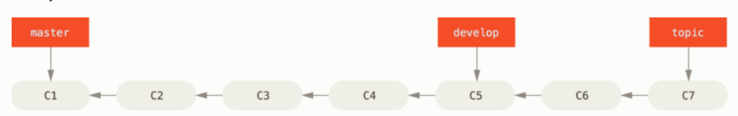
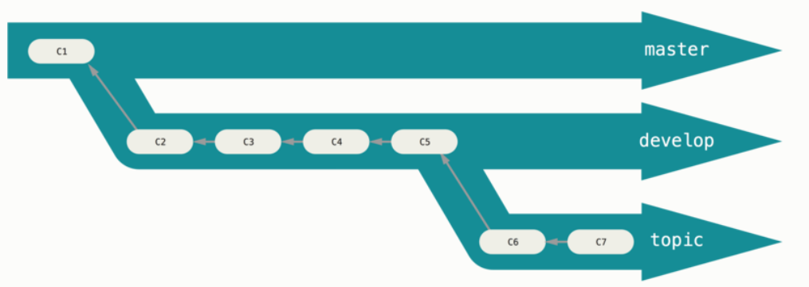
Branching strategy
Linear View of branching
A “silos” view of progressive stability branching

Slide 16
Branching in Git
Since Git stores data as a series of snapshots and not as a series of changes sets - it is able to provide support for branching more efficiently as compared to other VCS
When commit is done,
  A pointer to the snapshot of the staged content is stored
  This pointer object also contains author’s name and email address , commit message and pointer to the commit (s) immediately before the current commit
    Zero parents for the initial commit
    One parent for a normal commit
    Multiple parents for a commit resulting from a merge of tow or more branches

Slide 17
References : for further readings
Types of version control systems
https://subscription.packtpub.com/book/application_development/9781849517522/1/ch01lvl1sec12/types-of-version-control-systems
Git Book
https://git-scm.com/book/en/v2/Getting-Started-About-Version-Control
GitHub Pages
https://pages.github.com/

Slide 18
Next sessions :
GitHub commands
Collaboration and communication tools on GitHub
Working with GitHub pages
Understanding Markdown

